Slide 1
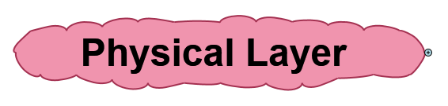

Slide 2
Network Topologies

Slide 3
Simple Physical Topologies
Physical topology: physical layout of nodes on a network
Three fundamental shapes:
Bus
Ring
Star
May create hybrid topologies
Topology integral to type of network, cabling infrastructure, and transmission media used

Slide 4
Bus
Single cable connects all network nodes without intervening connectivity devices
Devices share responsibility for getting data from one point to another
Terminators stop signals after reaching end of wire
Prevent signal bounce
Inexpensive, not very scalable
Difficult to troubleshoot, not fault-tolerant

Slide 5
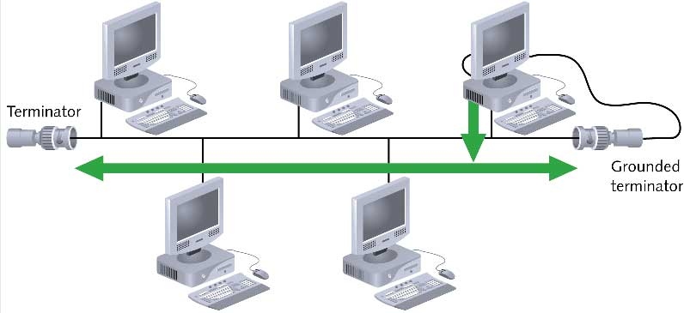
Bus (continued)

Slide 6
Advantages & Disadvantages of Bus Topology
Advantages
Works well for small networks
Relatively inexpensive to implement
Easy to add to it
Disadvantages
Management costs can be high
Potential for congestion with network traffic

Slide 7
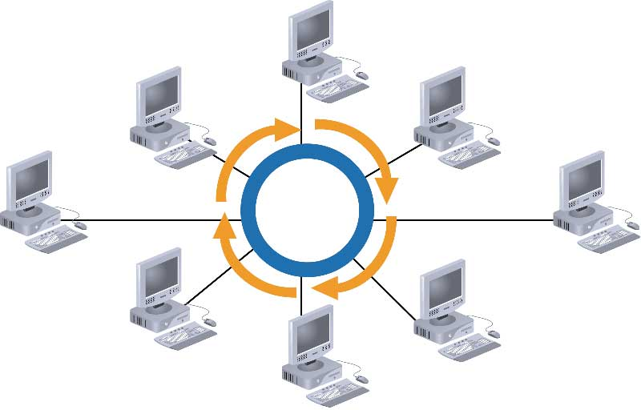
Ring

Slide 8
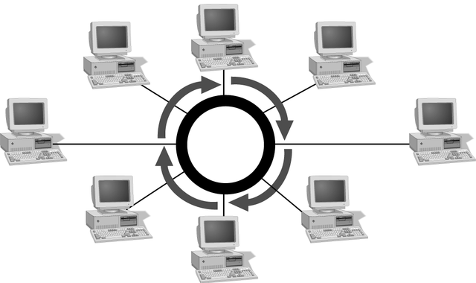
Simple Physical Topologies
Ring topology
Each node is connected to the two nearest nodes so the entire network forms a circle
One method for passing data on ring networks is token passing
Active topology
Each workstation transmits data

Slide 9
Advantages of Ring Topology
Easier to manage; easier to locate a defective node or cable problem
Well-suited for transmitting signals over long distances on a LAN
Handles high-volume network traffic
Enables reliable communication

Slide 10
Disadvantages of Ring Topology
Expensive
Requires more cable and network equipment at the start
Not used as widely as bus topology
Fewer equipment options
Fewer options for expansion to high-speed communication

Slide 11
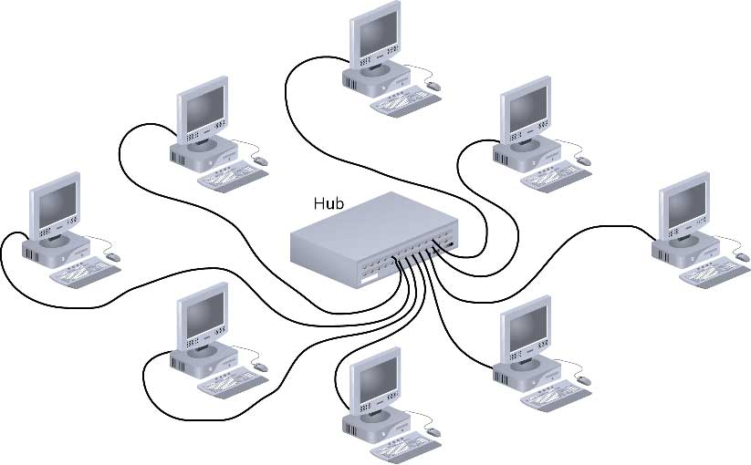
Star

Slide 12
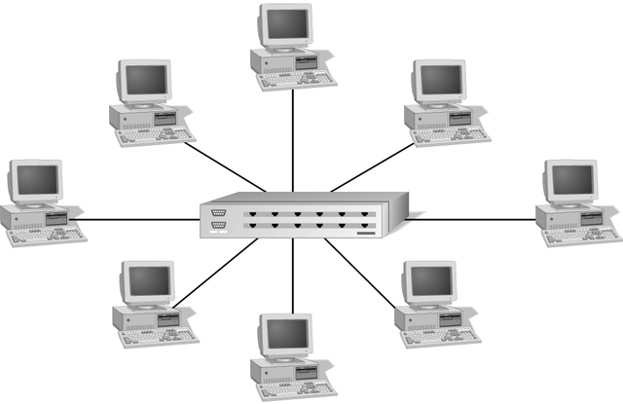
Simple Physical Topologies
Star topology
Every node on the network is connected through a central device

Slide 13
Star (continued)
Any single cable connects only two devices
Cabling problems affect two nodes at most
Requires more cabling than ring or bus networks
More fault-tolerant
Easily moved, isolated, or interconnected with other networks
Scalable
Supports max of 1024 addressable nodes on logical network

Slide 14
Advantages & Disadvantages of Star Topology
Advantages
Good option for modern networks
Low startup costs
Easy to manage
Offers opportunities for expansion
Most popular topology in use; wide variety of equipment available
Disadvantages
Hub is a single point of failure
Requires more cable than the bus

Slide 15
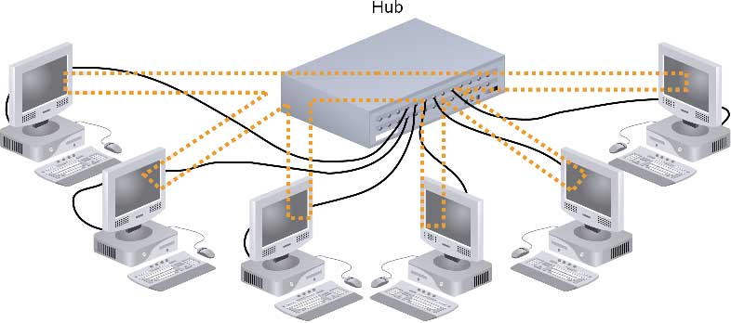
Hybrid Physical Topologies: Star-Wired Ring

Slide 16
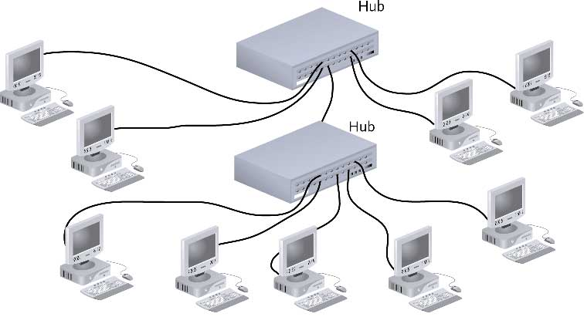
Star-Wired Bus

Slide 17
Backbone Networks: Serial Backbone
Daisy chain: linked series of devices
Hubs and switches often connected in daisy chain to extend a network
Hubs, gateways, routers, switches, and bridges can form part of backbone
Extent to which hubs can be connected is limited

Slide 18
Logical Topologiess
Logical topology: how data is transmitted between nodes
May not match physical topology
Bus logical topology: signals travel from one network device to all other devices on network
Required by bus, star, star-wired physical topologies
Ring logical topology: signals follow circular path between sender and receiver
Required by ring, star-wired ring topologies

